Slide 1

Statistical Analysis for Impact of Women on Country's Development
Anusha Kokkinti

Slide 2
Introduction:
United Nations Secretory-General Antanio Guterres stressed on Women’s empowerment are “essential to global progress”.
The empowerment and women autonomy of women and the improvement of their political, social, economic and health status is highly important for growth of the country.

Slide 3
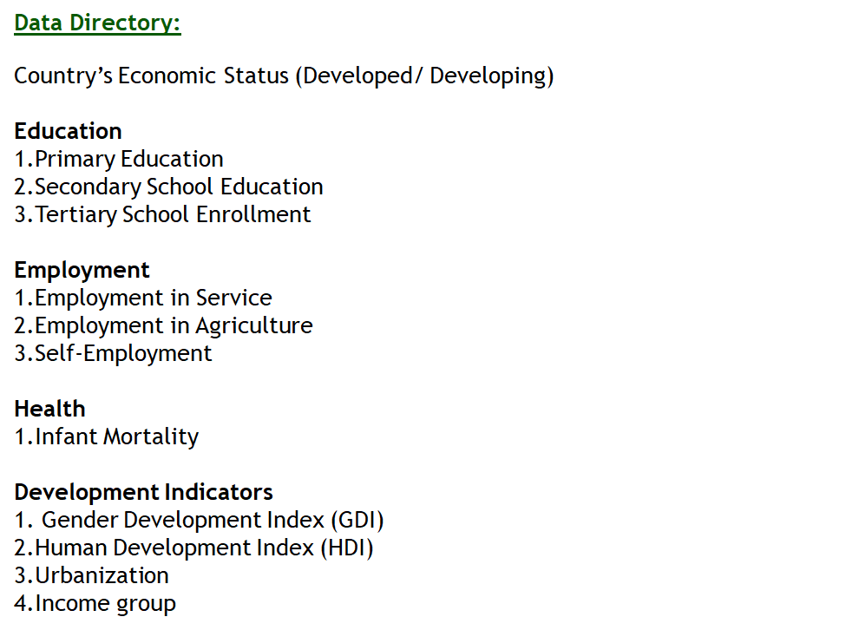

Slide 4
EDUCATION

Slide 5
Research Question
How the Women Education Impacting the "Development" Status of the Country?
Model used: Logistic regression
Dependent Variable: Status [Developed, Developing]
Independent Variables: wschoolenrolprimary, wschoolenrolsecondary, wschoolenrolltertiary

Slide 6
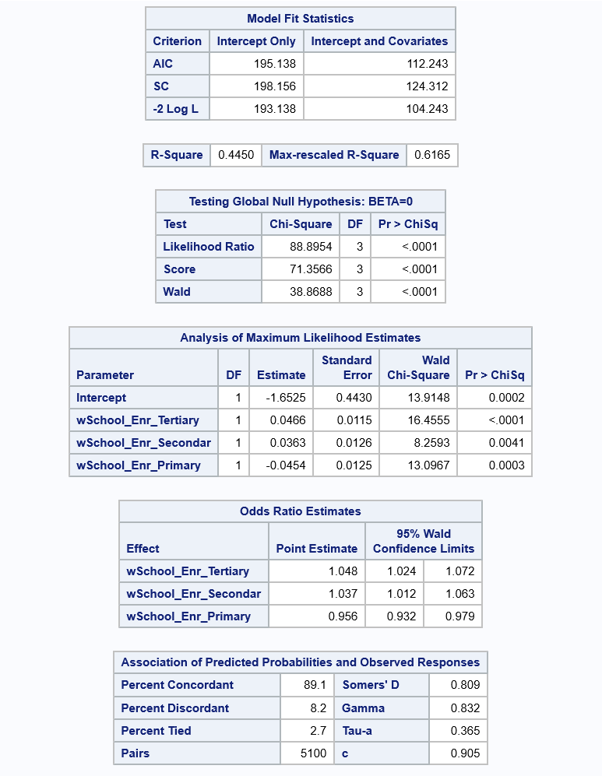

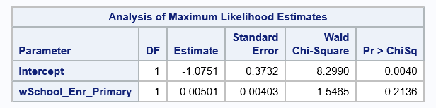
Analysis with School_Enr_Primary parameter

Slide 7
Interpretation
From the results, -2 log L with the parameters (104.243) is significantly less than the model with only intercepts (193.138).
The Wald’s Chi-Square test static’s p-value is less than 0.05. Hence the model is significant .
The log odds of country to gain a Developed status is decreasing by 44% for a percent increase in the women’s enrollment in the primary level schools. (Hence If women is just having primary education it doesn't make any difference, to dig deeper we ran separately (with just primary enrollment parameter) and found it's not a significant variable.
The log odds of country to gain a Developed status is Increasing by 37% for a percent increase in the women’s enrollment in the secondary level schools.
The log odds of country to gain a Developed status is Increasing by 48% for a percent increase in the women’s enrollment in the tertiary level schools.
C = 0.905, means around 90% rows correctly predicted the Status of the Countries.

Slide 8
Inference
Country Status whether being a Developed / developing is significantly impacted by % of women enrollment in schools for higher level of education. Encouraging women to attain progress towards higher levels of education will have positive results on country’s growth.

Slide 9
Research Question
Is Infant mortality rate different for different regions?
Hypothesis:
H0: mu1 = mu2 = mu3 = mu4...
H1: mu1 != mu2 or mu2 !=mu3 or mu3!=mu4 ….
Model Used: ANOVA

Slide 10
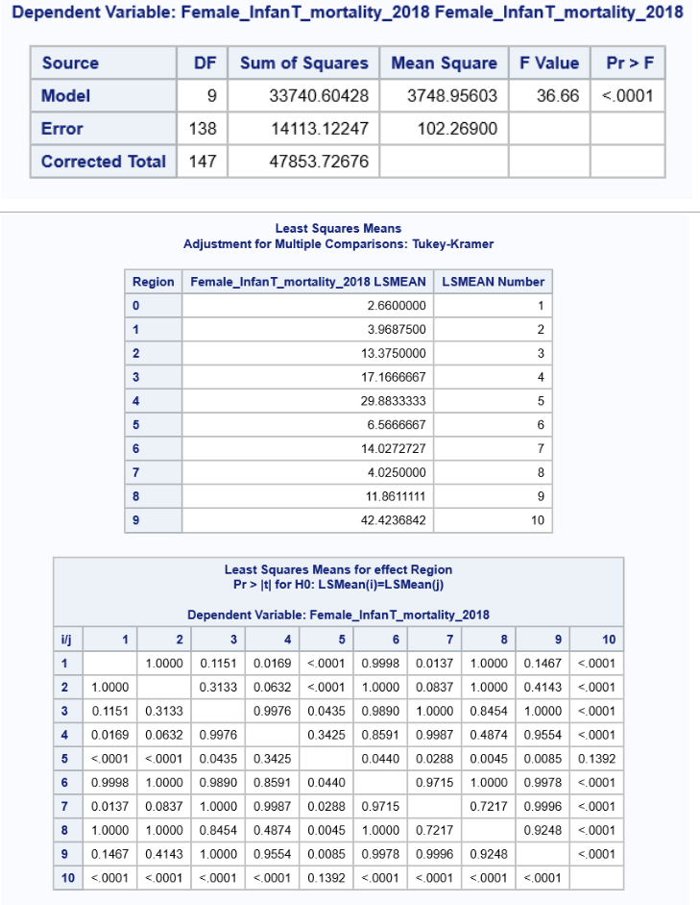

Slide 11
Interpretation
P-value < 0.0001 It means the model is significant. And there is at least one pair of region for which the infant mortality rate is significantly different.
To know which regions have significantly different means we performed the Turkey HSD(Honestly significant different) test. It is clear from the table that there are many pairs of regions for which infant mortality rate is significantly different.
Example P-value for Region 3 and Region 0 is 0.0169 which is smaller than 0.05 and hence for this pair of regions infant mortality rate is significantly different. Another pair of regions for which infant mortality rate is significantly different includes Region 4 & 0, Region 4 & 1, Region 4 & 2, Region 5 & 4, Region 6 & 0, Region 6 & 4, Region 7 & 4, Region 8 & 4, Region 9 & 0, Region 9 & 1, Region 9 & 2, Region 9 & 3, Region 9 & 5, Region 9 & 6, Region 9 & 7, Region 9 & 8 and Region 9 & 9.

Slide 12
Research Question
Is there any relationship between region and gender development index?
Model Used: CHI SQUARE
Hypothesis:
H0: Region and GDI are independent
H1: Region and GDI are dependent

Slide 13
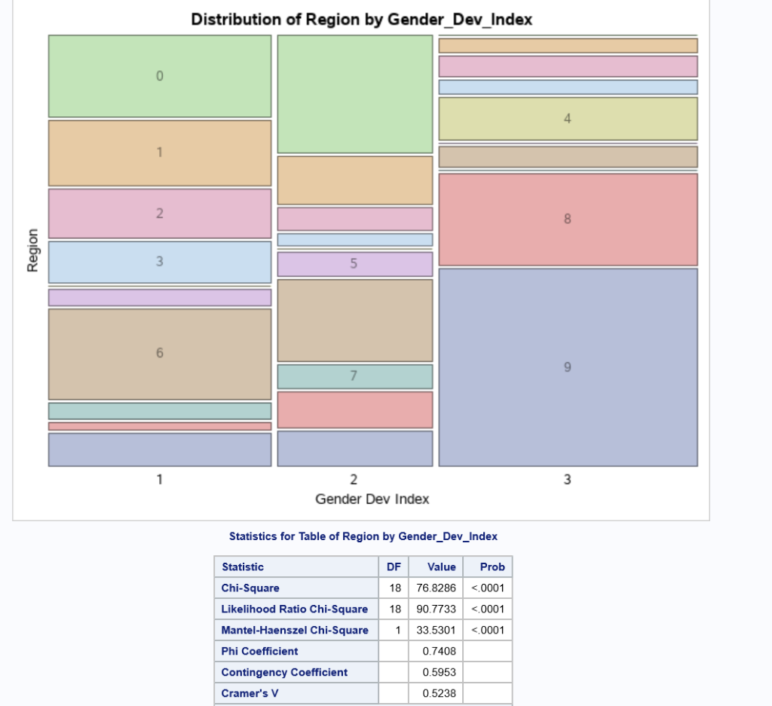

Slide 14
Interpretation
P-value < 0.0001 -> Reject Null Hypothesis
It means we have enough evidence to support Alternative Hypothesis.
Region & GDI are dependent.
From above “Distribution of Region by GDI” figure it is clear GDI (=1) is high for Region 6, GDI (=2) is high for Region 0 and GDI (=3) is high for Region 9.

Slide 15
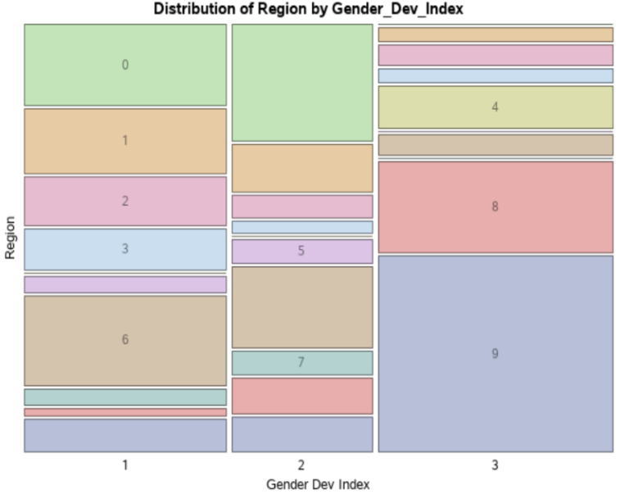
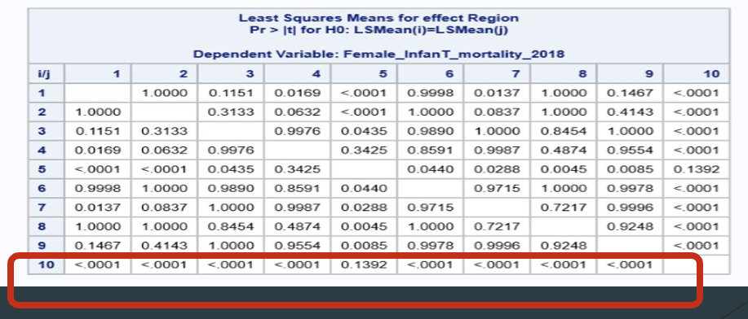
Inference
It is evident that if GDI (=3, gender inequality is more) for certain region is high, the infant mortality rate for that region will also High.

Slide 16
Research Question
Is infant mortality rate decreasing with the increase of women’s education across various levels?
Model Used: Multi-Linear Regression
Hypothesis:
For Slope-
H0: Slope for each independent variable is equal to zero
H1: Slope for each independent variable is not equal to zero
For Intercept-
H0: Intercept is equal to zero
H1: Intercept not equal to zero
Dependent Variable: female_infant mortality rate
Independent Variables: wschoolenrolprimary, wschoolenrolsecondary, wschoolenrolltertiary

Slide 17
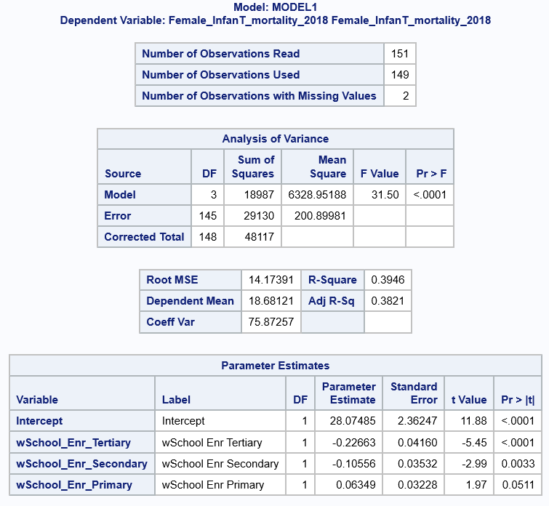

Slide 18
Interpretation
From the result, the model (with the parameters %womensenrollmentprimary, %womenenrollmentsecondary, %womenenrollmenttertiary to impact female infant mortality rate) is significant and explains around 38% of variation.
Women’s enrollment in primary level school education is not significant in impacting the female infant mortality rate.
A percentage increase in the women’s enrollment in secondary level education is decreasing female infant mortality rate approximately by 1 per 10000 female births.
A percentage increase in the women’s enrollment in Tertiary level education is decreasing female infant mortality rate approximately 2 per 10000 female births.

Slide 19
Inference
Increasing in the % of enrollments of women into higher levels of education will decrease the female infant mortality rate.

Slide 20
EMPLOYMENT

Slide 21
Research Question
How is the impact of women’s employment in areas like Industry, Agriculture, parliament on country’s GDP Per Capita. (Country development indicator)
Model Used : Multi Linear Regression
Dependent variable
GDP_Per_Capita
Independent Variables:
% WomenEmploymentIndustry
% WomenEmploymentAgriculture
% WomenEmploymentParliament

Slide 22
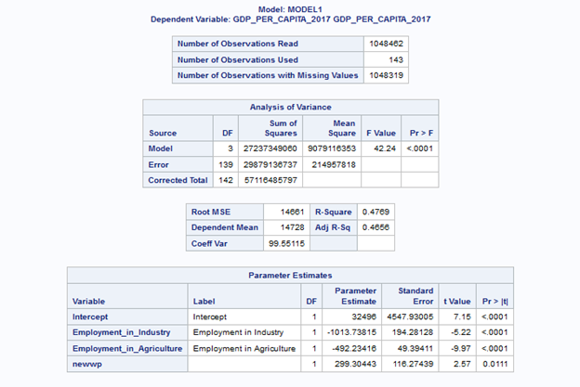

Slide 23
Interpretation
As the f-stat p-value <0.05, model is significant
A percent increase in Employment of Women in agriculture is Decreasing Country GDP per Capita by 492.2 dollars
A percent increase in Employment of Women in Industry is Decreasing Country’s GDP per Capita by –1013.738 dollars
A percent increase of women’s in parliament is increasing the country’s GDP per Capita by 299.30 dollars’

Slide 24
Inference
Increase in % of Women’s in parliament will positively impact country’s Economy.
Evaluation: According to International growth center research report, the constituencies that elect women experience significantly higher growth in economic activity through the electoral term than similar constituencies that elect men.
Increase in % of women’s employment in agriculture is not showing a positive impact on country’s Economy.
Evaluation: According to FAO report on gendered analysis on agriculture trade, women are generally associated with non-economic and unpaid work. So, their contribution is not registered in the system of national accounts and therefore no market value is given to the labor involved.

Slide 25
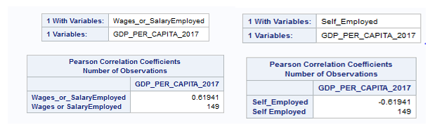
Inference
Increase in % of women’s employment in Industry is not showing a positive impact on country’s Economy.
Evaluation: Research on women by Catalyst in workforce states that Women’s work force participation rate declining globally. Which means that women are more interested into the self-employed leading to negative impact on economy.

Slide 26
Research Question
Testing the moderation effect of self-employment in the urban population on country’s economy.
Model Used : Moderation Analysis – Linear Regression
First checking the relationship between Urbanization and GDP Per Capita, Self Employed and GDP Per capita
Model Used : Linear Regression
Dependent Variable:
GDP_Per_Capita
Independent Variable:
Urban Population, WSelfEmployed

Slide 27
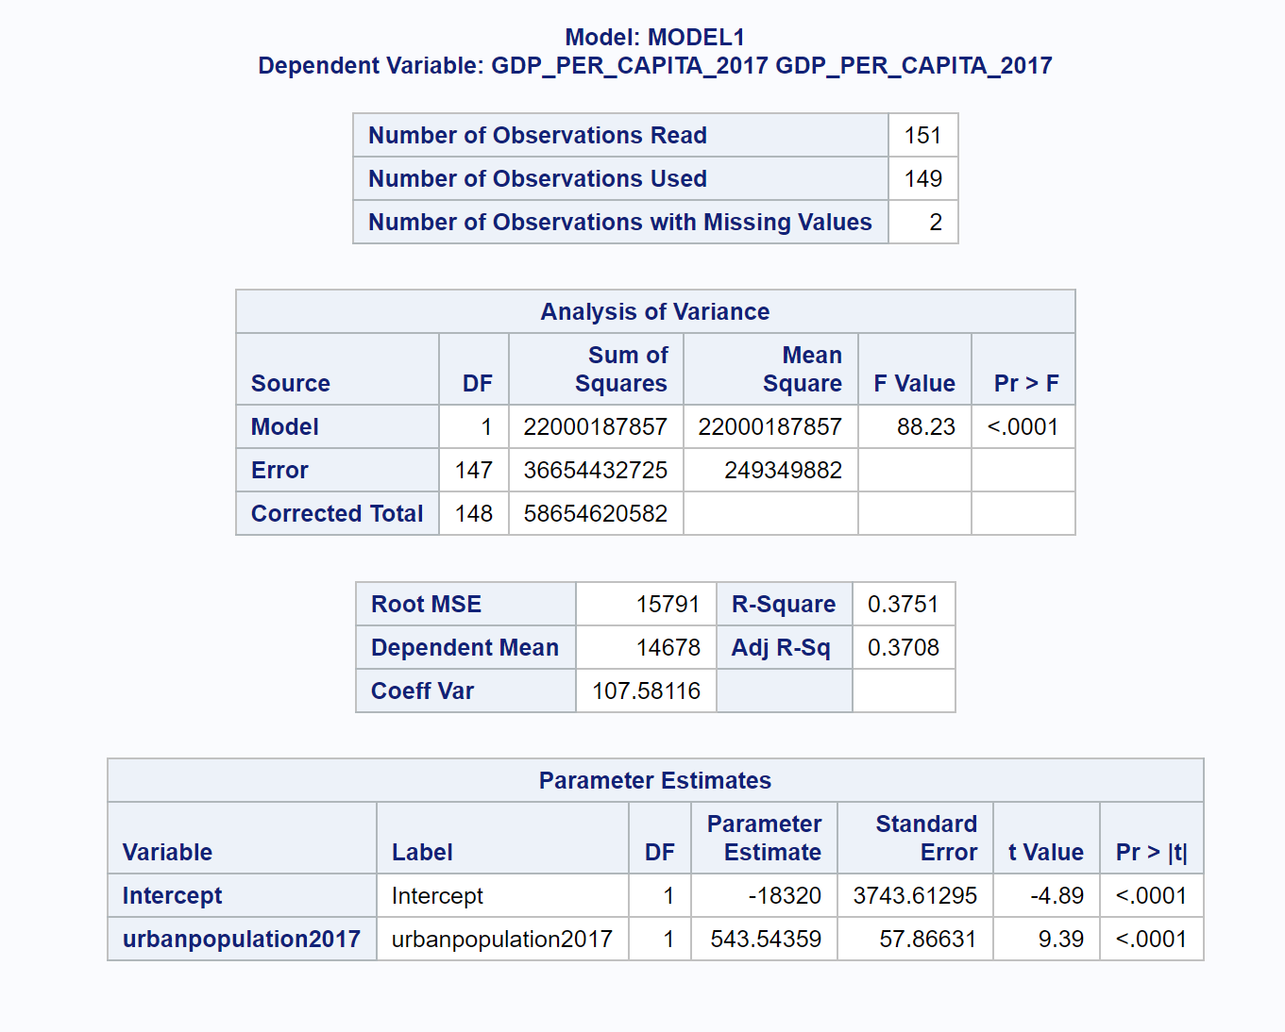

Slide 28
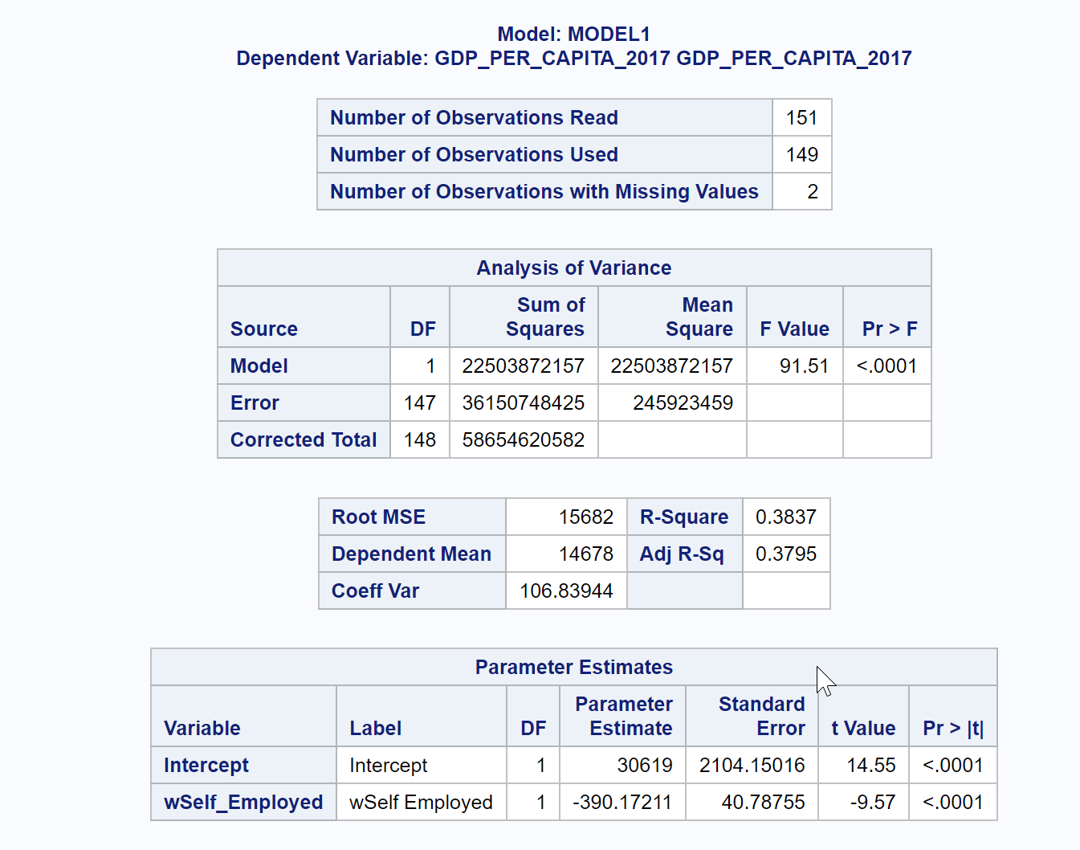

Slide 29
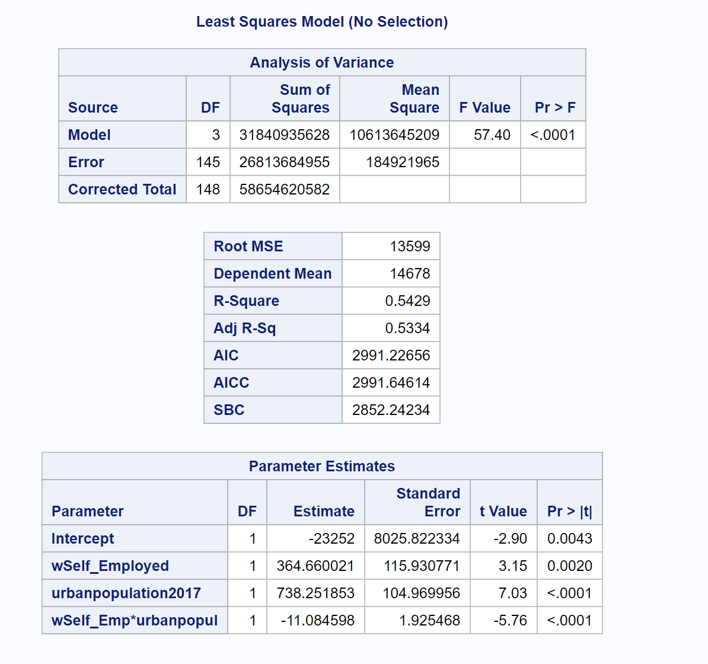
Analysis
Now checking the interaction effect of urbanization with Women being self- Employed as moderator on country’s economy.

Slide 30
Inference
The f-stat p value <0.05 , so the model is significant
The p-value for the interaction effect between self-employment and urban population is < 0.05 and hence significant.
So, it is evident that, though urbanization have positive impact on country’s economy, it will be hampered, if there is increase in more of a self-employed woman.

Slide 31
Research Question
a. Can the Log odds of country gaining Developed status be decided by Employment to population ratio?
Model used : Logistic Regression
Dependent Variable : Status
Independent Variable : Employment-to-Population Ration
Result : Model is not significant
Why?

Slide 32
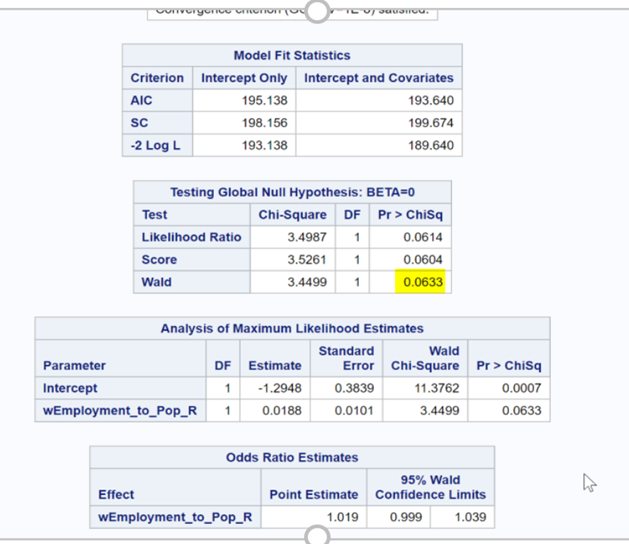

Slide 33
Research Question
b. Can the Log odds of country gaining Developed status be decided by Employment to population ratio and % of vulnerable Employment (women)
Model used : Logistic Regression
Dependent Variable : Status
Independent Variable : Employment-to-Population Ration, % of Vulnerable Employment women.
Result : Model is significant

Slide 34
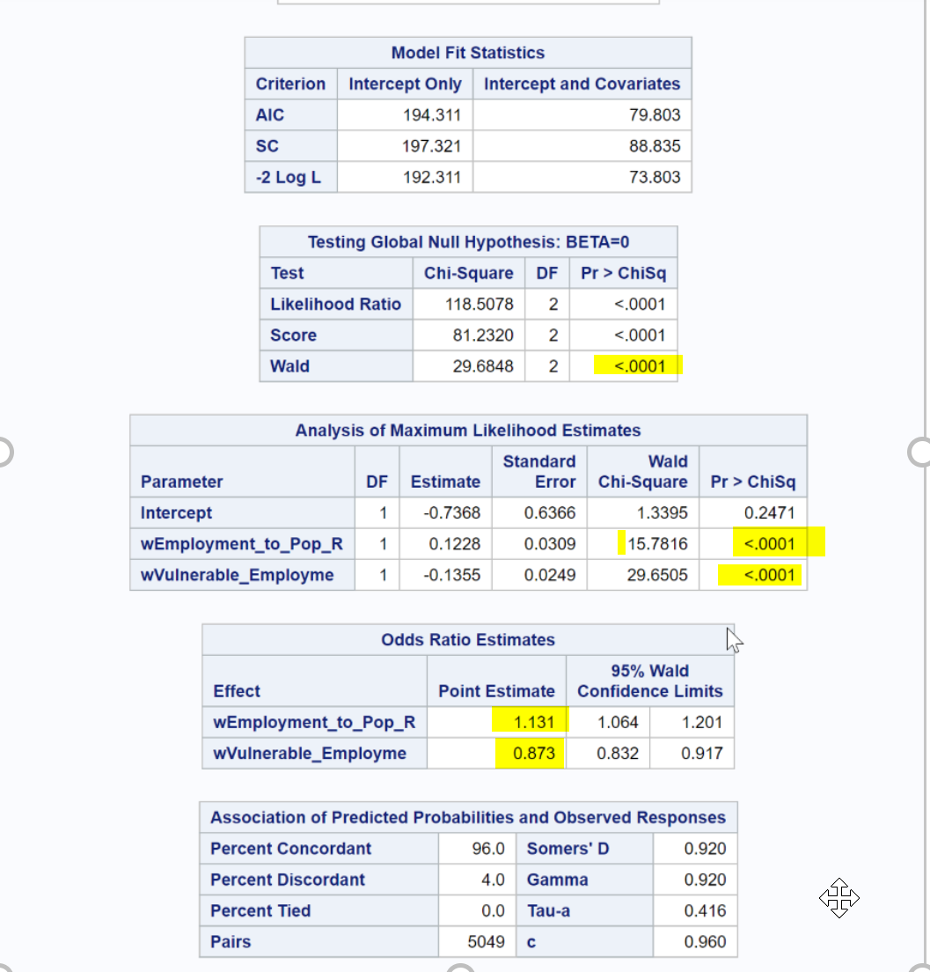

Slide 35
Research Question
c. Is there an interaction effect between variables Employment-to-Population ration and Vulnerable Employment
Model used : Logistic Regression(Interaction Effect)
Dependent Variable : Status
Independent Variable : Employment-to-Population Ration, % of Vulnerable Employment women.
Result : Model is significant

Slide 36
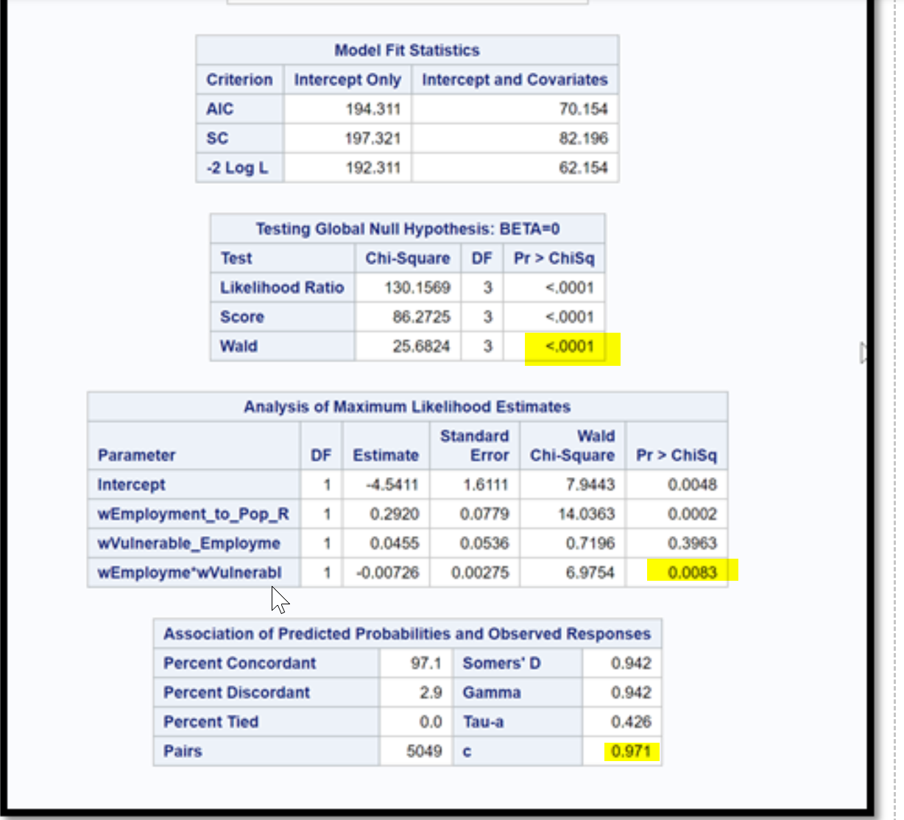

Slide 37
Inference
The p-value corresponding to Wald’s Chi-Square is <0.05
The p-value corresponding to Interaction element’s Estimate is <0.05
C – value is 0.971 greater than model without interaction effect.
So, It is evident that the Effect of Employment to population ratio on country’s development is dependent on % of Vulnerable Employment(Women)

Slide 38
Research Question:
a. Is There any correlation between % of Vulnerable Employment and HDI
Model used: Correlation Analysis
Variables used :
% of Vulnerable Employment women.
HDI(Human Development Index)
Result : Higher Negative Correlation exists.

Slide 39
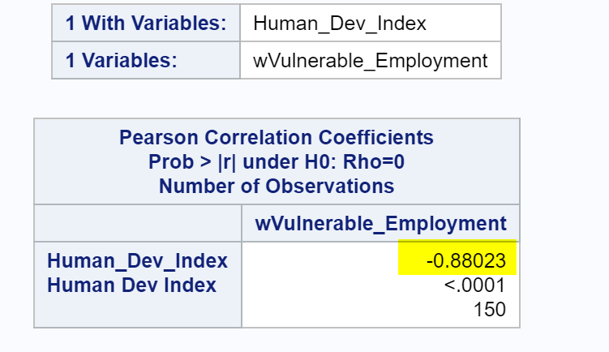

Slide 40
Research Question:
b. Is Vulnerable Employment across countries divided into regions by geographic area.
Model used: ANOVA
Variables used :
% of Vulnerable Employment women.
regions
Result : model is significant
Region 9, 4 are significantly different from most of the regions.
9 – Sub Saharan Africa
4- south Asia
Why?

Slide 41
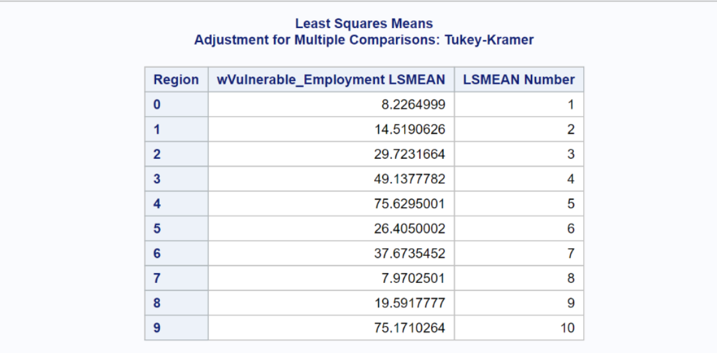
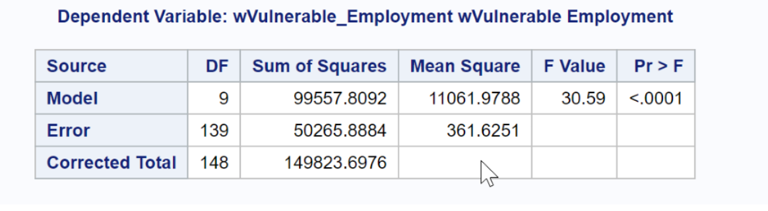
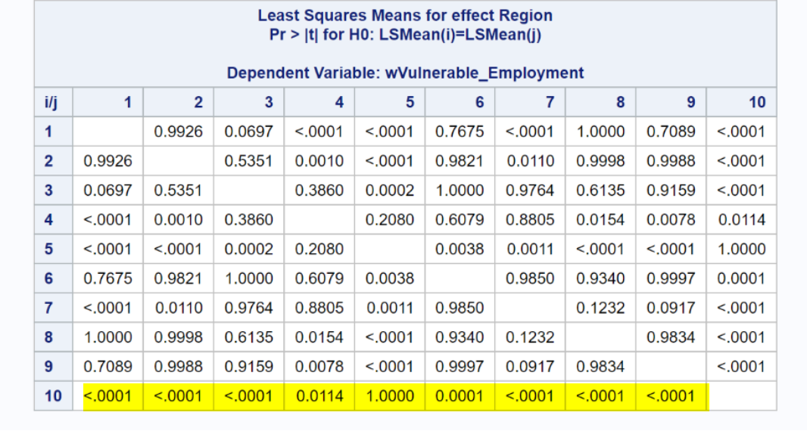

Slide 42
Interpretations
The Regions 4, 9 are significantly different from other regions but both of them are not.
Why?
Is There any Relation with Gender Inequality?
Yes.
More countries with higher gender inequality.

Slide 43
Inference
Country’s with more suppression towards Women have significant difference in their % of Vulnerable Employment.

Slide 44
Conclusion
1.Suppression of women through gender equality is impacting the country’s development.
This is tested through mortality rate and vulnerable employment.
2. Progress in women’s education definitely has a positive impact on country’s development.
3. Encouraging women for higher education levels might have positive impact in such cases.
4. While urbanization can be positive factor for country’s economy, having more self-employed people lead to the negative impact on the country’s economy .
5. More women in parliament should be encouraged for a country’s positive development and gender equality has to be improved for the contribution of women in agriculture and industry to improve economy

Slide 45
THANK YOU!

